Slide 1
What is Internet?
-> Whatever we can see online is because of internet.
-> The Internet also called as net.
-> It is a worldwide system of computer networks.
-> By using Internet we can share any information online from one Pc to another.

Slide 2
HTTP
-> Hypertext Transfer Protocol.
-> It is the rule book for transferring any files eg. such as text, images, sound, video etc.
-> And it is possible through web, when user open a browser they are indirectly using HTTP.

Slide 3
HTTPS
-> Hypertext Transfer Protocol Secure.
-> It is an extension of HTTP.
-> More secure and widely used on internet.
-> Secure Socket Layer (SSL)/Transport Layer Security (TLS) protocol.

Slide 4
WWW
-> World Wide Web
-> World Wide Web, which is also known as a Web.
->It is a collection of websites or web pages stored on web servers and connected to local computers through the internet.
-> These websites contain text pages, digital images, audio, videos, etc.

Slide 5
Domain Name
-> It is the name of a website.
-> It's what comes after "@" in an email address, or after "www." in a web address.
-> If someone asks how to find you online, what you tell them is usually your domain name.

Slide 6

Top Domain Name
->Domain names are a key part of the Internet infrastructure. They provide a human-readable address for any web server available on the Internet.
Structure of domain names
A domain name has a simple structure made of several parts (it might be one part only, two, three…), separated by dot
s and read from right to left:

Slide 7
SEO
-> Search Engine Optimization.
-> It is the process by which we get our website on top in search engine result page(SERP).
-> Digital Marketer use it to rank website on top of SERP.
-> It's our responsibility to make a website Seo Friendly .

Slide 8
What is HTML?
-> HTML stands for HyperText Markup Language.
-> It is used to structure the web page
-> It is a scripting language which used by browser to render the page on WWW(World wide web).
-> It is not a programming language.
-> it is markup language. Html is parsed by the browser and then browser display the web page.
-> It consist a series of element.
-> It tells browser how to display web page.

Slide 9
What is text editor.
-> Editors are basically computer programs that are utilised to edit files on a computer.
-> They provide environment to a programmer to create, edit, update, format a document in any order he/she wants to. In system programming or programming, editors are software or tools that are used to edit the program.
-> Visual studio code
-> sublime
-> Notepad++

Slide 10
Web Browser
-> It is a an application to explore world wide web.
-> It provide a interface between user and server.
-> whatever a client or user want to see web browser helps to display the content.
-> The information which we want to display through web browser is transferred from HTTP.

Slide 11
Downloading Text Editor
-> https://code.visualstudio.com/download
-> from here we can download text editor.
-> During our course we will use Vs code as a text editor.

Slide 12
HTML Structure
-> Html structure is mainly divided into two parts.
Head
-> It contains the information about the Html document. Like meta data, title, version, links etc.
Body
-> It contain everything which we want to display on internet.

Slide 13
Structure
<!DOCTYPE html>
<html>
<head>
<title>Title of page</title>
</head>
<body>
<h1>Heading</h1>
<p>Paragraph</p>
</body>
</html>

Slide 14
First Program in HTMl
<!DOCTYPE html>
<html>
<head>
<title>Tops Technologies</title>
</head>
<body>
<h1>Tops</h1>
<p>Best It Institute in Gujarat</p>
</body>
</html>

Slide 15
HTML Introduction
-> Html stand for Hypertext Markup Language.
-> It consist a series of element.
-> It describe a structure of a web page.
-> The element of html tells the browser how to display content.
-> Tim Berners Lee in 1993 first introduce the version of Html.

Slide 16
HTML Getting started
-> What is html?
-> structure of html
-> introduction of html

Slide 17
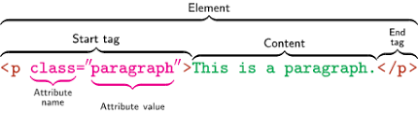
HTML Element
-> first <html> is the root element of Html document it defines the html document.
-> an html element consists of an opening tag - some content - closing tag.

Slide 18
HTML Attributes
-> they are used in html tag to change the behaviour of element or display of element.
-> with the help of attributes we can change the color, size, fonts or whatever we want to change in an element.
-> https://developer.mozilla.org/en-US/docs/Web/HTML/Attributes here we can check the various attributes used in html.
-> They always come in start tag. Like <starttag name=”value”>content</endtag>
-> for eg.
<a href="https://developer.mozilla.org/en-US/docs/Web/HTML/Attributes">Visit For attributes</a>

Slide 19
HTML Basic Tags
-> <!DOCTYPE html>
-> <html>
-> <head>
-> <title>
-> <body>
-> <h1> to <h6>
-> <p>
-> <br>
-> <hr>
-> for more https://developer.mozilla.org/en-US/docs/Web/HTML/Element

Slide 20
HTML DOCTYPES
-> It is a first line of code when we write html document.
-> It is a declaration of html document.
-> it tells the browser that in which version we are writing the html document.
-> It is not a tag it is just a declaration for telling the browser that what version we are using and then browser display accordingly.
-> This is written as <!DOCTYPE html>

Slide 21
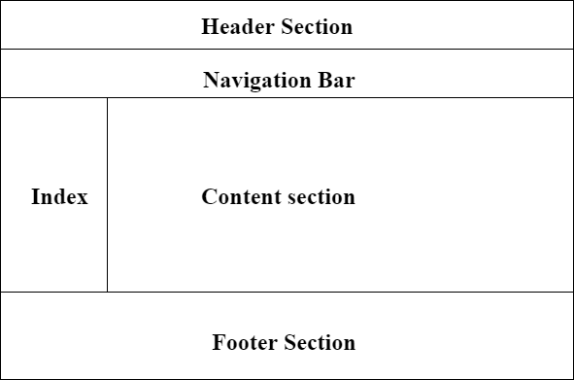
HTML Layout

Slide 22
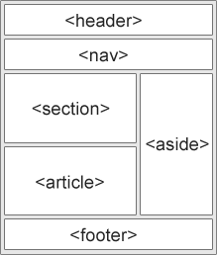
HTML Layout
-> Html layout consist of several element like header, nav bar, section, article, aside, footer etc.
->

Slide 23
<!DOCTYPE html>
<html lang="en-US">
<head>
<meta charset="utf-8">
<meta name="viewport" content="width=device-width">
<title>My page title</title>
<link rel="stylesheet" href="style.css">
</head>
<body>
<header>
<h1>

Slide 24
</header>
<nav>
<ul>
<li>Home</li>
<li>Our team</li>
<li>Projects</li>
<li>Contact</li>
</ul>
<form>
<input type="search" name="q" placeholder="Search query">
<input type="submit" value="Go!">
</form>
</nav>

Slide 25
<main>
<article>
<h2>heading 2</h2>
<p>para </p>
</article>
<aside>
<h3>heading 3</h3>
</aside>
</main>
<footer>
<p>para</p>
</body>
</html>

Slide 26
HTML Head
-> As we earlier discussed about Html head that what it consist :-
-> So it contain some meta information such as document, style, script, title etc.which are machine readable like browser wants these info and act accordingly.
-> for eg.
<!DOCTYPE html>
<html lang="en-US">
<head>
<meta charset="UTF-8">
<meta name="viewport" content="width=device-width">
<title>Document title</title>
</head>
</html>

Slide 27
HTML Meta
-> it contain some meta information which are generally meant for browser to read and display page accordingly.
-> such as base, script, style, title, link etc.
-> which character set we are using , viewport etc.
-> These meta info are always written in the head section of a html document.
-> For eg as i mentioned in meta.html file

Slide 28
HTML Script
> This is used for adding javascript to html document..
-> Syntax for adding javascript is
<script> </script>
-> for eg i mentioned in script.html

Slide 29
Create Any Simple Web Page To Show Our Name
-> for this watch my name.html

Slide 30
Importance of Meta Tag and Doctypes
-> As we discussed about both of them in our earlier lecture that what is the importance of Doctype in Html and Meta tag in Html.
-> Doctype is used for telling version to browser
-> meta tag is used to tell browser that what we are using and in what way browser will display web page.

Slide 31
Tags and Self Closing Tags
-> So, there are several tags in html and some don't need to be closed.
-> that tags which don't need to be closed are called void tag or empty tag.
-> so here is the list of html tags
-> https://developer.mozilla.org/en-US/docs/Web/HTML/Element
-> some self closing tags which are commonly used are <br>, <hr>, <img> etc

Slide 32
Attributes and Events
-> As we already discussed about what is attributes and why we use them in our earlier lecture.
-> for reference
-> https://developer.mozilla.org/en-US/docs/Web/HTML/Attributes

Slide 33
Events

Slide 34
Marquee Tag
-> The Marquee tag is used for creating scrollable text or image in a web page.
-> But now this tag is been depreciated in html 5 i.e not so important now in html 5
-> for eg as i mentioned in marquee.html

Slide 35
HTML Comments
-> when we want write something to remember in text editor like vs code.
-> we have to comment it in our html document so that browser don't show it on web.
-> <!-- comments here -->

Slide 36
HTML Image
-> For display a image in html document we use img tag
-> syntax for img tag is
<img src=”image.jpg” alt=”Image” width=”100px” height=”100px”>
-> src and alt are required attributes in img tag.
-> src defined the path of the image
-> alt is alternative text for image when the image for some reason can not be displayed

Slide 37
-> if we want to hyperlink an image we insert img in anchor tag
-> <a href=”Some link here.com”>
<img src=”image.jpg” alt=”Image”>
</a>
-> for reference I mentioned in image.html

Slide 38
HTML Tables
-> For reference go to table.html

Slide 39
HTML Lists
-> Types of list in html document.
-> ordered list - it starts with <ol>
-> unordered list - it starts with <ul>
-> Description list - it starts with
<dl>
<dt>Coffee</dt>
<dd> - hot drink </dd>
<dt>Tea</dt>
<dd> -cold drink </dd>
</dl>
-> <li> is List Item
-> for further eg go to list.html

Slide 40
HTML Text Links
-> Links are hyperlinks in html document.
-> links are given in html document to go through them to another page.
-> Text links are when we use link on text i.e when we click on some text we will be redirected to another page
-> syntax for link is
<a href=”url”>text here</a>.
For eg go to my links.html

Slide 41
-> Absolute url
-> the full address of link
-> Relative Url
-> local link of a page in same website
-> we can link to an Image
-> we can link to an Email Address
-> we can link to a button by using JavaScript.

Slide 42
HTML Heading and Paragraph
-> html heading are from <h1> to <h6>
-> paragraph <p> tag

Slide 43
HTML Text formatting
-> these are designed to display special type text
-> <b> - Bold text
<strong> - Important text
<i> - Italic text
<em> - Emphasized text
<mark> - Marked text
<small> - Smaller text
<del> - Deleted text
<ins> - Inserted text
<sub> - Subscript text
<sup> - Superscript text

Slide 44
HTML Styles
-> Html style means that how we write our html document.
-> first we have to write the declaration Doctype such as <!DOCTYPE html> in our html document.
-> html allows us write code in whatever we use like lowercase, uppercase letters.
-> but for best practice always try to use same letters and specially lowercase because it is easy to write and looks good in html document.
-> we have to close our html tags every time we use them
-> Always remember that we must have to quote our attributes value
-> always try to specify alt in image our in any other tag width and height given to any image looks good
-> title is very important so always write it

Slide 45
-> viewport always mention
-> metadata always mention
-> language
-> comments any thing which is not in code or something which you wrote for your purpose to remember when you saw it again
->

Slide 46
HTML Frame
-> Html frame are now not use in html5 i.e it does not support frame

Slide 47
HTML Iframe
-> It is an inline frame or we can say the context is nested in it.
-> we can embed any other browsing context in it
-> for reference go to my iframe.html
-> https://developer.mozilla.org/en-US/docs/Web/HTML/Element/iframe

Slide 48
HTML Blocks and Inline
-> There are 2 type of display values
Block
Inline
-> In block level every time it starts form new line and takes full width
Such as <p>, <div> etc
-> In Inline level it takes only required space
Such as <span> <a> etc
-> for reference go to my block.html page
-> https://developer.mozilla.org/en-US/docs/Web/HTML/Block-level_elements
-> https://developer.mozilla.org/en-US/docs/Web/HTML/Inline_elements

Slide 49
HTML Image Map
-> https://www.image-map.net/
-> For reference visit my mapping.html

Slide 50
HTML Forms
-> Html forms is used for taking users information or user data.
-> <form> tag is used to create a form
-> for reference visit my form.html page

Slide 51
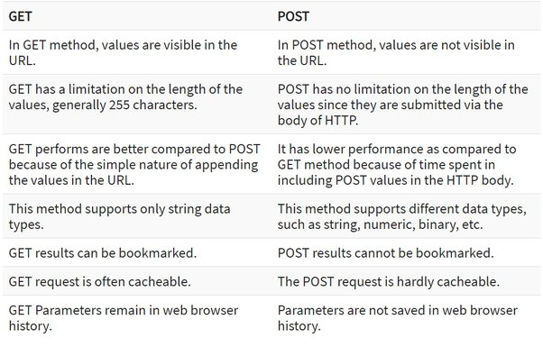

Slide 52
HTML Tags Reference
-> https://developer.mozilla.org/en-US/docs/Web/HTML/Element
-> Html tags are used to create a element.
-> for more reference go to my tag.html page.

Slide 53
HTML ASCII Code
-> ASCII stands for American standard Code for Information Interchange.
-> These are also called as Html Entities.
-> for reference https://www.tutorialspoint.com/html/html_entities.htm
-> -> for more reference visit my entity.html page

Slide 54
HTML Fonts
-> html fonts are same as we have fonts in Ms word etc
-> but in html the html fonts are now applied by using CSS font family property.
-> for more reference visit my font.html page

Slide 55
HTML Color
-> html color tag is also a deprecated tag in html.
-> now we use CSS properties to give color in html document
-> for reference visit my color.html page

Slide 56
HTML Deprecated tag
-> the tags which are not longer in use.
-> https://www.geeksforgeeks.org/html-deprecated-tags/

Slide 57
The HTML head Element
The <head> element primarily is the container for all the head elements,
which provide extra information about the document (metadata), or
reference to other resources that are required for the document to display or
behave correctly in a web browser
The head elements collectively describes the properties of the document such as title, provide meta information like character set, instruct the browser where to find the style sheets or scripts that allows you to extend the HTML document in a highly active and interactive ways
The HTML elements that can be used inside the <head> element are: <title>,<base>, <link>, <style>, <meta>, <script> and the <noscript> element

Slide 58
HTML Lists
Working with HTML Lists
HTML lists are used to present list of information in well formed and
semantic way. There are three different types of list in HTML and each
one has a specific purpose and meaning.
• Unordered list — Used to create a list of related items, in no particular order.
• Ordered list — Used to create a list of related items, in a specific order.
• Description list — Used to create a list of terms and their descriptions.

Slide 59
Lists
HTML Unordered Lists
An unordered list created using
the <ul> element, and each list
item starts with the <li> element.
HTML Ordered Lists
• An ordered list created using the <ol>
element, and each list item starts with
the <li> element. Ordered lists are
used when the order of the list'sitems
is important.

Slide 60
Ex
<ul> <li>Coffee</li> <li>Tea</li> <li>Milk</li> </ul>
Value | Description
disc | Sets the list item marker to a bullet (default)
circle | Sets the list item marker to a circle
square | Sets the list item marker to a square
none | The list items will not be marked

Slide 61
Ex
<ol> <li>Coffee</li> <li>Tea</li> <li>Milk</li> </ol>
Type | Description
type="1" | The list items will be numbered with numbers (default)
type="A" | The list items will be numbered with uppercase letters
type="a" | The list items will be numbered with lowercase letters
type="I" | The list items will be numbered with uppercase roman numbers
type="i" | The list items will be numbered with lowercase roman numbers

Slide 62
HTML Description Lists
A description list is a list of items with a description or definition of each item.
The description list is created using <dl> element. The <dl> element is
used in conjunction with the <dt> element which specify a term, and
the <dd> element which specify the term's definition.
<dl> <dt>Coffee</dt> <dd>Black hot drink</dd> <dt>Milk</dt> <dd>White cold drink</dd> </dl>

Slide 63
Html table
Creating Tables in HTML HTML table allows you to arrange data into rows and columns. They are commonly used to display tabular data like product listings, customer's details, financial reports, and so on.
You can create a table using the <table> element. Inside the <table> element, you can use the <tr> elements to create rows, and to create columns inside a row you can use the <td> elements. Youcan also define a cell as a header for a group of table cells using the <th> element

Slide 64
Spanning Multiple Rows and Columns
Spanning allow you to extend table rows and columns across multiple other rows and columns.
Normally, a table cell cannot pass over into the space below or above another table cell. But, you can use the rowspan or colspan attributes to span multiple rows or columns in a table.

Slide 65
Adding Captions to Tables
You can specify a caption (or title) for your tables using the <caption>
element.
The <caption> element must be placed directly after the opening
<table> tag. By default, caption appears at the top of the table, but you
can change its position using the CSS caption-side property

Slide 66
Html cellspassing / cellpadding
HTML tables can adjust the padding inside the cells, and also the space between the cells.
Cell Padding - Cell padding is the space between the cell edges and the cell content. By default the padding is set to 0
Cellspassing - Cell spacing is the space between each cell.
By default the space is set to 2 pixels.

Slide 67
Defining a Table Header, Body, and Footer
HTML provides a series of tags <thead>, <tbody>, and <tfoot> that helps you to create more structured table, by defining header, bodyand footer regions, respectively.
Ex
https://github.com/HRpanchal1/wd-training-modul-1-2/blob/master/modul-1%20html/18table/intro.html
https://github.com/HRpanchal1/wd-training-modul-1-2/blob/master/modul-1%20html/18table/table1.html

Slide 68
HTML Forms
HTML Forms are required to collect different kinds of user inputs, such as contact details like name, email address, phone numbers, or details like credit card information, etc.
Forms contain special elements called controls like inputbox, checkboxes, radio-buttons, submit buttons, etc. Users generally complete a form by modifying its controls e.g. entering text, selecting items, etc. and submitting this form to a web server for further processing.

Slide 69
HTML Forms Elements
Input Element
Text Fields
Password Field .
Radio Buttons
Checkboxes x
File Select box
Textarea
Select Boxes
Submit and Reset Buttons
Grouping Form Controls
https://github.com/HRpanchal1/wd-training-modul-1-2/tree/master/modul-1%20html/19Formb

Slide 70
Frequently Used FormAttributes
Attribute Description
Name - Specifies the name of the form.
action - Specifies the URL of the program or script on the web server that will be used for
processingthe
Information - submitted via form.
Method - Specifies the HTTP method used for sending the data to the web server by the
browser. The value can be
either get - (the default) and post.
Target - Specifies where to display the response that is received after submitting the form
Possiblevalues are _blank, _self, _parent and _top.
enctype - Specifies how the form data should be encoded when submitting the form to the
server. Applicable only when the value of the method attribute is post.

Slide 71
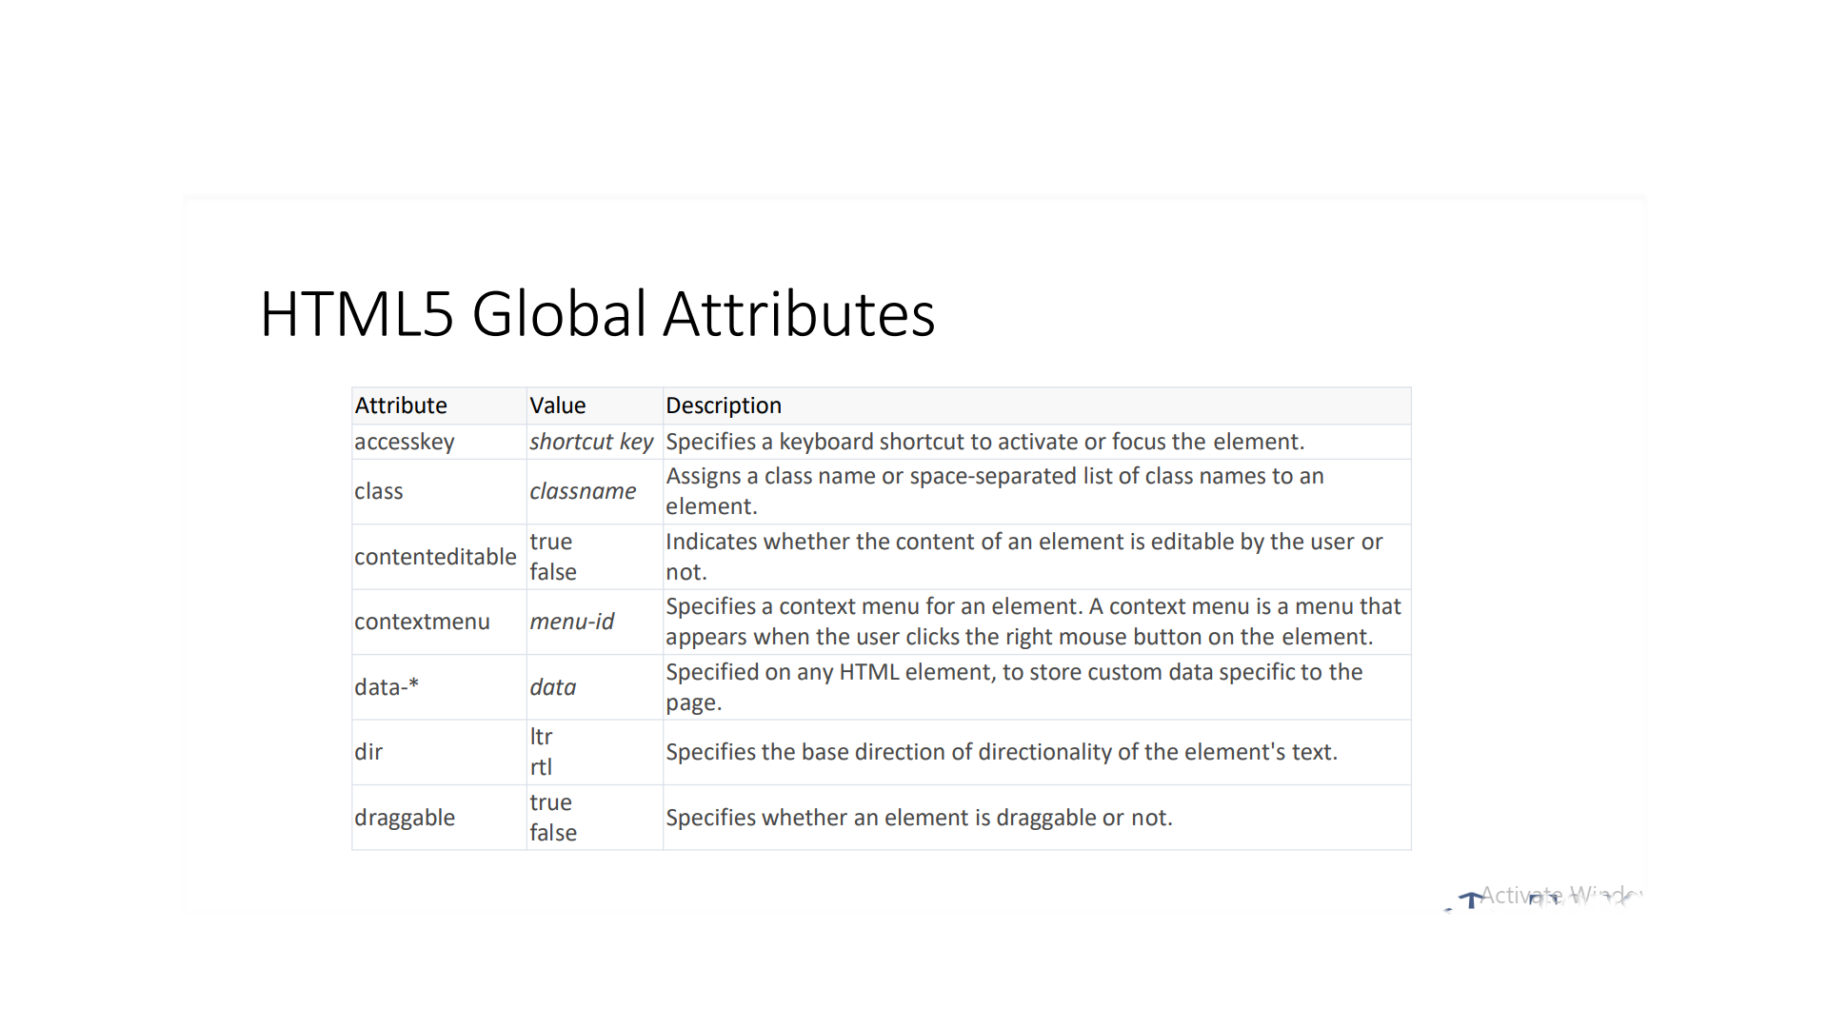

Slide 72
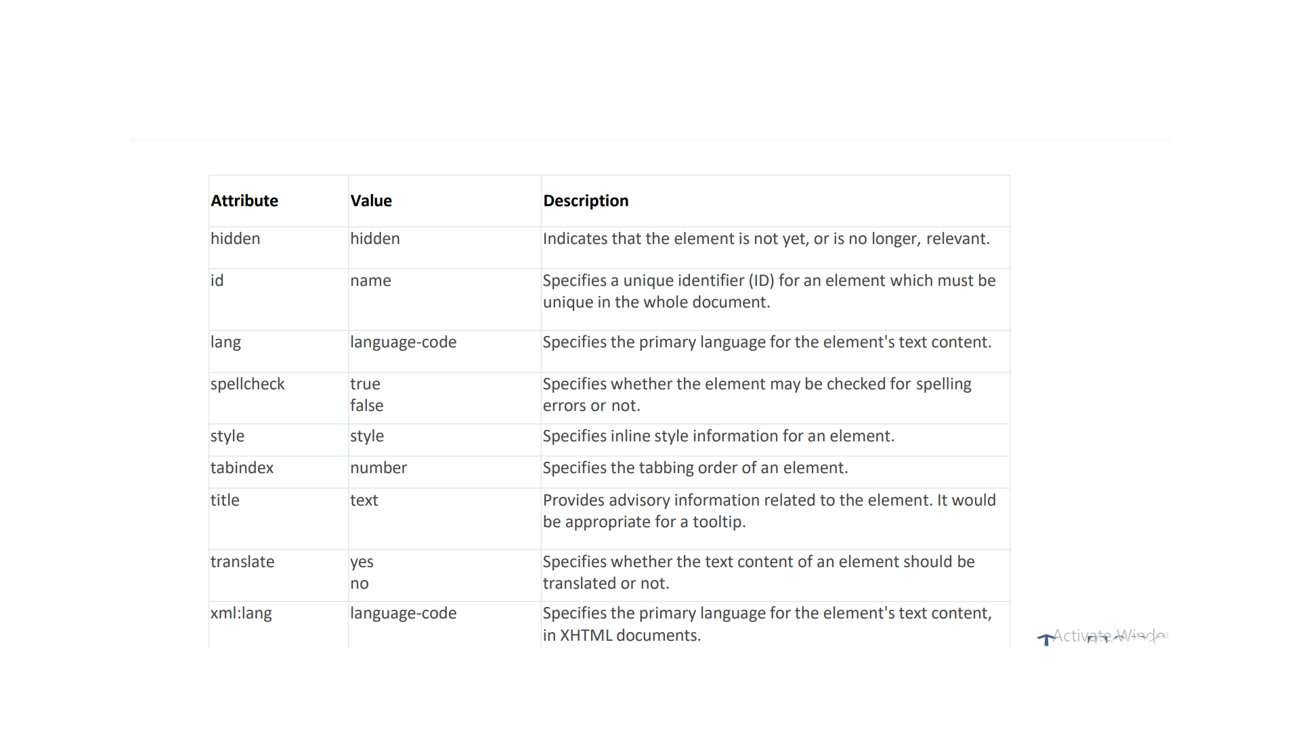

Slide 73
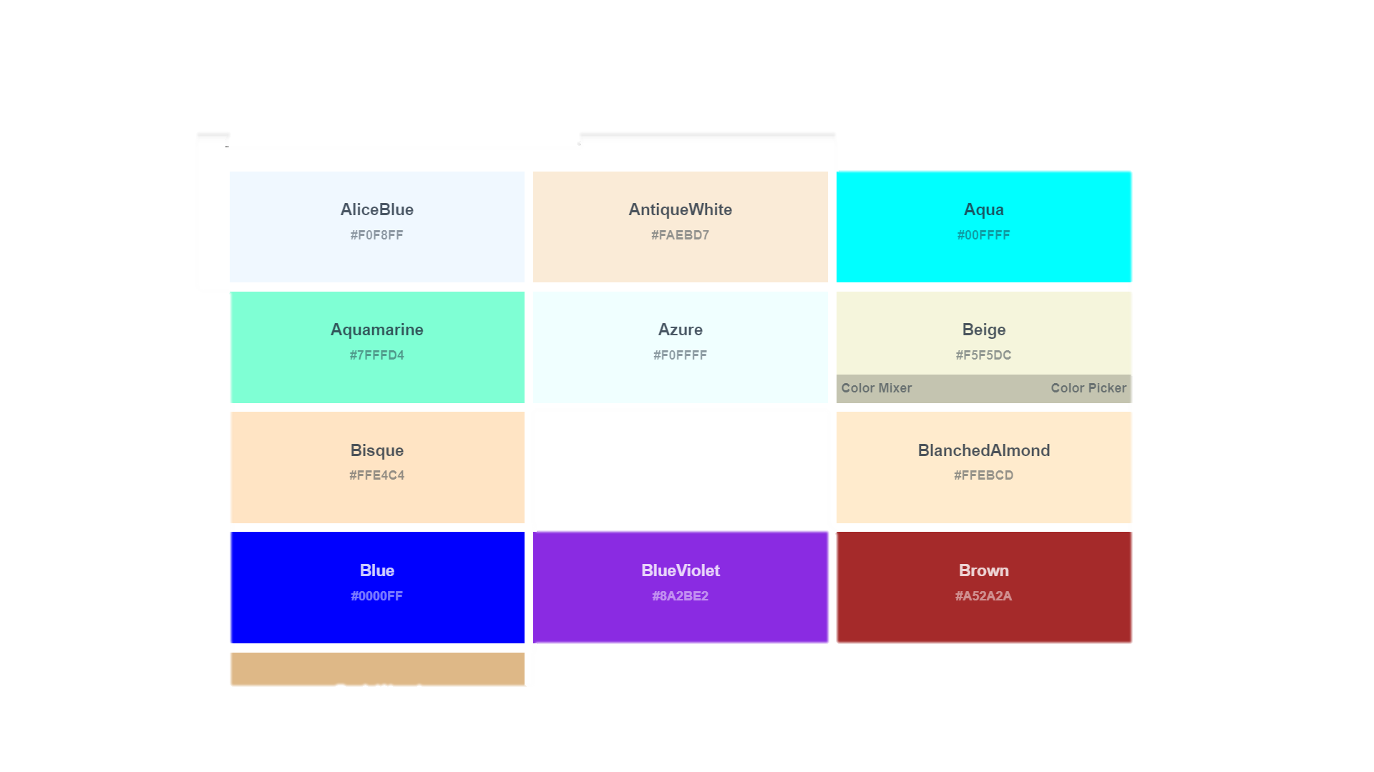
HTML Color Names
Color Names Supported by All Browsers
All modern browsers support the following 140 color names (click on a color name, or a hex value, to view the color as the background-color along with different text colors):

Slide 74
HTML Entities
HTML Entities
Some characters are reserved in HTML.
If you use the less than (<) or greater than (>) signs in your text, the browser might mix them with tags.
Character entities are used to display reserved characters in HTML.
A character entity looks like this:
&entity_name;OR
&#entity_number;
To display a less than sign (<) we must write: &lt; or &#60;

Slide 75
HTML - Deprecated Tags
HTML Deprecated Attributes
A complete list of deprecated HTML tags and attributes are given here. All the tags have been ordered alphabetically along with their equivalent tag or alternate CSS option.
<basefont> | Deprecated. Specifies a base font
<center> | Deprecated. Specifies centered text | text-align
<dir> | Deprecated. Specifies a directory list
<embed> | Deprecated. Embeds an application in a document | <object>
<font> | Deprecated. Specifies text font, size, and color | font-family, font-size
<isindex> | Deprecated. Specifies a single-line input field
<listing> | Deprecated. Specifies listing of items | <pre>
<menu> | Deprecated. Specifies a menu list
<plaintext> | Deprecated. Specifies plaintext | <pre>
<s> | Deprecated. Specifies strikethrough text | text-decoration
<strike> | Deprecated. Specifies strikethrough text | text-decoration
<u> | Deprecated. Specifies underlined text | text-decoration
<xmp> | Deprecated. Specifies preformatted text | <pre>

Slide 76
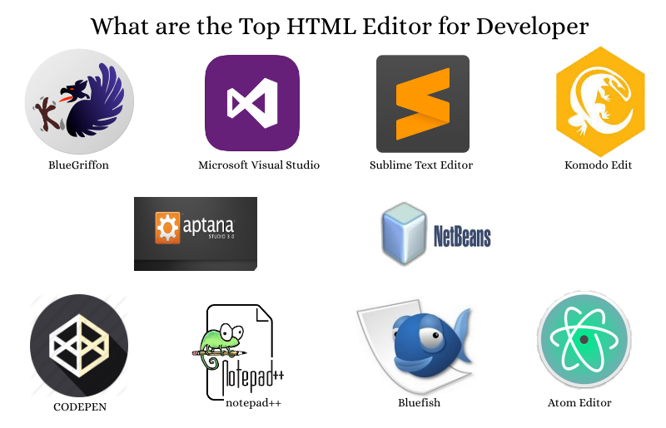
HTML EDITOR
Some of these editors also provide features of making a project, managing all the files related to the web, etc. Examples of HTML Text editors include-Notepad++, VSCode,Sublime Text.

Slide 77
HTML iFrame
An iframe or inline frame is used to display external objects including other web pages within a web page. An iframe pretty much acts like a mini web browser within a web browser. Also, the content inside an iframe exists entirely independent from the surrounding elements.
<iframe src="hello.html"></ziframe>
Removing Default Frameborder
<iframe src="hello.html" style="border: none;"></iframe>
<iframe src="hello.html" style="border: 2px solid
blue;"></iframe>
Using an iFrame as Link Target
<iframe src="demo-page.html" name="myFrame"></iframe> <p><a
href="https://www.jayamins.com"
target="myFrame">Open Jay Amin’s Website</a></p>

Slide 78
HTML5 structural elements
Tag Description
<header> - Represents the header of a document or a section.
<footer> - Represents the footer of a document or a section.
<nav> - Represents a section of navigation links.
<section> - Represents a section of a document, such as header,
footer etc.
<article> - Represents an article, blog post, or other selfcontained unit of
information.
<aside> - Represents some content loosely related to the page
content.

Slide 79
HTML FONTS
The following fonts are the best web safe fonts for HTML and CSS:
Arial (sans-serif)
Verdana (sans-serif)
Helvetica (sans-serif)
Tahoma (sans-serif)
Trebuchet MS (sans-serif)
Times New Roman (serif)
Georgia (serif)
Garamond (serif)
Courier New (monospace)
Brush Script MT (cursive)
Note: Before you publish your website, always check how your fonts appear
on different browsers and devices, and always use fallback fonts!

Slide 80
Practical Examples:
https://github.com/HRpanchal1/wd-training-modul-1-2

